Slide 1
How to use variadic templates properly
Petko Padevski
15.09.2016

Slide 2
print(std::ostream, …);
print(std::cout, 12);
print(std::cout, 12, "34”);
print(std::cout, 12, "34", std::string("5678"));
print(std::cerr, 12, "34", std::string("5678"));
print(std::cerr, 1, ”234", std::string("5678"));
print(std::cerr, ”12”, 34, std::string("5678"));
print(std::cerr, ”1”, 234, std::string("5678"));

Slide 3
namespace demo {
template<class... Args>
void print(std::ostream& os, Args... args);
} // namespace demo

Slide 4
namespace demo {
template<class... Args>
void
print(std::ostream& os,
Args... args)
{
int x[] = { _print(os, args)... };
os << std::endl;
}
} // namespace demo
template<class T>
int
_print(std::ostream& os,
T t);
{
os << t;
}

Slide 5
int
main()
{
demo::print(std::cout, 12);
demo::print(std::cout, 12, "34");
demo::print(std::cout, 12, "34", std::string("5678"));
}
$ ./a.out
12
1234
12345678

Slide 6
template<class... Args>
void
print(std::ostream& os,
Args... args)
{
…
}
int
main()
{
demo::print(std::cout, 12, "34", std::string("5678"));
}
But is it efficient though?

Slide 7
namespace demo {
template<class... Args>
void
print(std::ostream& os,
const Args&... args)
{
int x[] = { _print(os, args)... };
os << std::endl;
}
} // namespace demo
template<class T>
int
_print(std::ostream& os,
const T& t);
{
os << t;
}

Slide 8
int
main()
{
demo::print(std::cout, 12);
demo::print(std::cout, 12, "34");
demo::print(std::cout, 12, "34", std::string("5678"));
demo::print(std::cerr, 1, ”234", std::string("5678"));
demo::print(std::cerr, ”12”, 34, std::string("5678"));
demo::print(std::cerr, ”1”, 234, std::string("5678"));
}
$ ./a.out
12
1234
12345678
12345678
12345678
12345678

Slide 9
int
main()
{
demo::print(std::cout, 12);
demo::print(std::cout, 12, "34");
demo::print(std::cout, 12, "34", std::string("5678"));
demo::print(std::cerr, 1, ”234", std::string("5678"));
demo::print(std::cerr, ”12”, 34, std::string("5678"));
demo::print(std::cerr, ”1”, 234, std::string("5678"));
}
How many print functions is the compiler going to generate?
$ ./a.out
12
1234
12345678
12345678
12345678
12345678

Slide 10
namespace demo {
void
f(int)
{
}
} // namespace demo
$ nm –C a.out
00000000004005c0 T demo::f(int)

Slide 11
namespace demo {
template<class... Args>
void
print(std::ostream& os,
const Args&... args);
} // namespace demo
int
main()
{
demo::print(std::cout, 12);
demo::print(std::cout, 12, "34");
demo::print(std::cout, 12, "34", std::string("5678"));
demo::print(std::cerr, 1, ”234", std::string("5678"));
demo::print(std::cerr, ”12”, 34, std::string("5678"));
demo::print(std::cerr, ”1”, 234, std::string("5678"));
}

Slide 12
$ nm –C a.out
demo::print(std::cout, 12);
demo::print(std::cout, 12, "34");
0000000000400fa9 W void demo::print<int>(std::ostream&,
int const&)
0000000000400fe2 W void demo::print<int,
char [3]>(std::ostream&,
int const&,
char const (&) [3])

Slide 13
$ nm –C a.out
demo::print(std::cout, 12, "34", std::string("5678"));
demo::print(std::cerr, 1, ”234", std::string("5678"));
0000000000401035 W void demo::print<int,
char [3],
std::string>(std::ostream&,
int const&,
char const (&) [3],
std::string const&)
00000000004010a2 W void demo::print<int,
char [4],
std::string>(std::ostream&,
int const&,
char const (&) [4],
std::string const&)

Slide 14
$ nm –C a.out
demo::print(std::cerr, ”12”, 34, std::string("5678"));
demo::print(std::cerr, ”1”, 234, std::string("5678"));
000000000040110f W void demo::print<char [3],
int,
std::string>(std::ostream&,
char const (&) [3],
int const&,
std::string const&)
000000000040117c W void demo::print<char [2],
int,
std::string>(std::ostream&,
char const (&) [2],
int const&,
std::string const&)

Slide 15
$ nm –C a.out
demo::print(std::cout, 12, "34");
0000000000400fe2 W void demo::print<int,
char [3]>(std::ostream&,
int const&,
char const (&) [3])

Slide 16
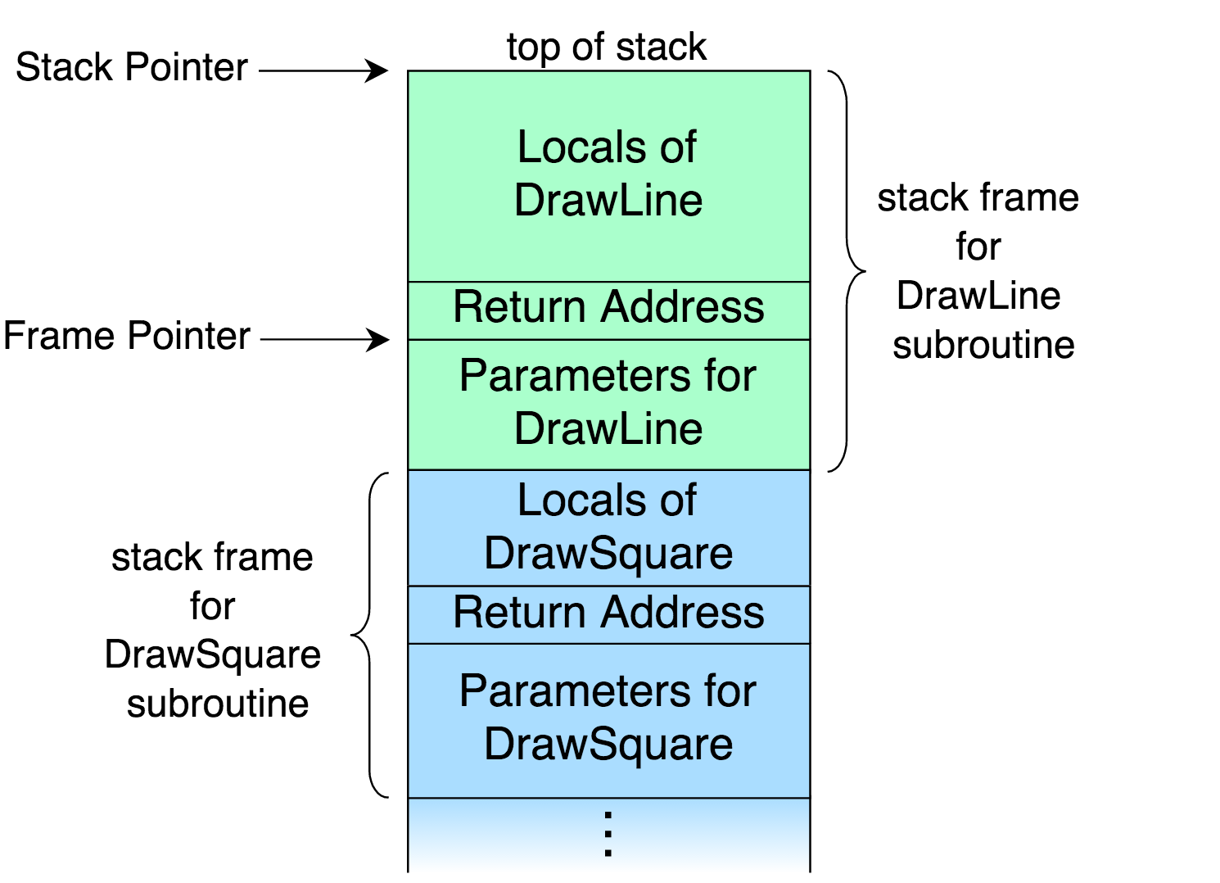
* https://en.wikipedia.org/wiki/Call_stack

Slide 17
template<class... Args>
void print(std::ostream& os, Args... args);
$ nm –C a.out
void demo::print<int>(std::ostream&, int)
void demo::print<int, char const*>(std::ostream&,
int,
char const*)
void demo::print<int, char const*, std::string>(std::ostream&,
int,
char const*,
std::string)
void demo::print<char const*, int, std::string>(std::ostream&,
char const*,
int,
std::string)

Slide 18
Goal
Accept scalars and arrays by value
Accept everything else by reference

Slide 19
Type traits define a compile-time template-based interface to query or modify the properties of types.
* http://en.cppreference.com/w/cpp/types

Slide 20
namespace std {
template<class T> struct is_reference {
static constexpr bool value = false;
};
template<class T> struct is_reference<T&> {
static constexpr bool value = true;
};
template<class T> struct is_reference<T&&> {
static constexpr bool value = true;
};
} // namespace std
* http://en.cppreference.com/w/cpp/types/is_reference
* http://en.cppreference.com/w/cpp/types

Slide 21
struct A { };
int
main()
{
std::cout << std::boolalpha;
std::cout << std::is_reference<A>::value << std::endl;
std::cout << std::is_reference<A&>::value << std::endl;
std::cout << std::is_reference<A&&>::value << std::endl;
std::cout << std::is_reference<int>::value << std::endl;
std::cout << std::is_reference<int&>::value << std::endl;
std::cout << std::is_reference<int&&>::value << std::endl;
}
$ ./a.out
false
true
true
false
true
true

Slide 22
namespace std {
template<class T> struct remove_reference {
typedef T type;
};
template<class T> struct remove_reference<T&> {
typedef T type;
};
template<class T> struct remove_reference<T&&> {
typedef T type;
};
} // namespace std
* http://en.cppreference.com/w/cpp/types/remove_reference
* http://en.cppreference.com/w/cpp/types

Slide 23
struct A { };
int
main()
{
// A& a0; // error: ‘a0’ declared as reference but not initialized
std::remove_reference<A>::type a1;
std::remove_reference<A&>::type a2;
std::remove_reference<A&&>::type a3;
std::remove_reference<int>::type i1;
std::remove_reference<int&>::type i2;
std::remove_reference<int&&>::type i3;
}

Slide 24
template< class T > struct decay {
private:
typedef typename std::remove_reference<T>::type U;
public:
typedef typename std::conditional<
std::is_array<U>::value,
typename std::remove_extent<U>::type*,
typename std::conditional<
std::is_function<U>::value,
typename std::add_pointer<U>::type,
typename std::remove_cv<U>::type
>::type
>::type type;
};
* http://en.cppreference.com/w/cpp/types/decay

Slide 25
std::decay<int>::type int
std::decay<int&>::type int
std::decay<int&&>::type int
std::decay<const int&>::type int
std::decay<volatile int>::type int
std::decay<int[2]>::type int*

Slide 26
template<class T>
struct Decay {
typedef ? type;
};
int const int
int& const int
const int const int
volatile int const int
string const string&
string& const string&
const string& const string&
volatile string& const string&

Slide 27
template<class T>
struct Decay {
typedef ? type;
}
T[] const T* const
T[N] const T* const
const T[] const T* const
const T[N] const T* const
volatile T[] const volatile T* const
volatile T[N] const volatile T* const
T* const T* const
T*& const T* const
T* const const T* const
const T* const T* const
volatile T* const volatile T* const

Slide 28
template<class T>
struct _Decay {
typedef typename std::conditional<
std::is_scalar<T>::value,
const T,
const T&
>::type type;
};
template<class T>
struct _Decay<T*> {
typedef const T* const type;
};
template<class T>
struct Decay {
typedef typename std::decay<T>::type U;
typedef typename _Decay<U>::type type;
};

Slide 29
template<class... Args>
void
print_decayed(std::ostream& os,
Args... args)
{
int x[] = { _print(os, args)... };
os << std::endl;
}
template<class... Args>
void
print(std::ostream& os,
const Args&... args)
{
print_decayed<typename Decay<Args>::type...>(os, args...);
}

Slide 30
template<class... Args>
void
print(std::ostream& os,
const Args&... args)
{
print_decayed<typename Decay<Args>::type...>(os, args...);
}
How many print functions is the compiler going to generate?

Slide 31
template<class... Args>
inline void
print(std::ostream& os,
const Args&... args)
{
print_decayed<typename Decay<Args>::type...>(os, args...);
}
How many print functions is the compiler going to generate?

Slide 32
#if defined __GNUC__
# define INLINE inline __attribute__((__always_inline__))
#else // #ifdef _MSC_VER
# define INLINE __inline
#endif
template<class... Args>
INLINE void
print(std::ostream& os,
const Args&... args)
{
print_decayed<typename Decay<Args>::type...>(os, args...);
}

Slide 33
int
main()
{
demo::print(std::cout, 12);
demo::print(std::cout, 12, "34");
demo::print(std::cout, 12, "34", std::string("5678"));
demo::print(std::cerr, 1, ”234", std::string("5678"));
demo::print(std::cerr, ”12”, 34, std::string("5678"));
demo::print(std::cerr, ”1”, 234, std::string("5678"));
}
$ ./a.out
12
1234
12345678
12345678
12345678
12345678

Slide 34
int
main()
{
demo::print(std::cout, 12);
demo::print(std::cout, 12, "34");
demo::print(std::cout, 12, "34", std::string("5678"));
demo::print(std::cerr, 1, ”234", std::string("5678"));
demo::print(std::cerr, ”12”, 34, std::string("5678"));
demo::print(std::cerr, ”1”, 234, std::string("5678"));
}
How many print functions is the compiler going to generate?
$ ./a.out
12
1234
12345678
12345678
12345678
12345678

Slide 35
$ nm –C a.out
W void demo::print_decayed<int const>(std::ostream,
int const)
W void demo::print_decayed<int const,
char const* const>(std::ostream&,
int const,
char const* const)
W void demo::print_decayed<int const,
char const* const,
std::string const&>(std::ostream&,
int const,
char const* const,
std::string const&)
W void demo::print_decayed<char const* const,
int const,
std::string const&>(std::ostream&,
char const* const,
int const,
std::string const&)

Slide 36
Key takeaways
Accept scalars and arrays by value
Accept everything else by reference

Slide 37
Thank You

